Slide 1
MATH 585

Slide 2
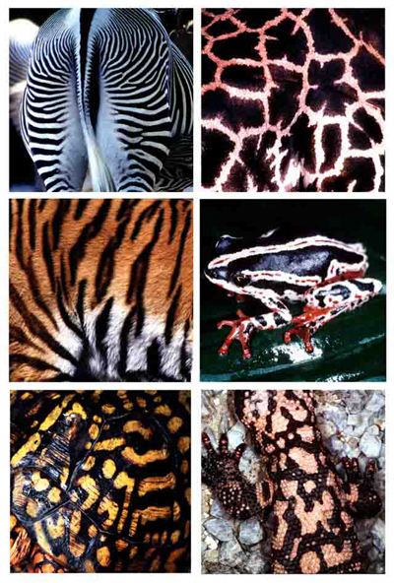
Pattern Formation by Reaction-Diffusion (RD)
Fahim Alam

Slide 3
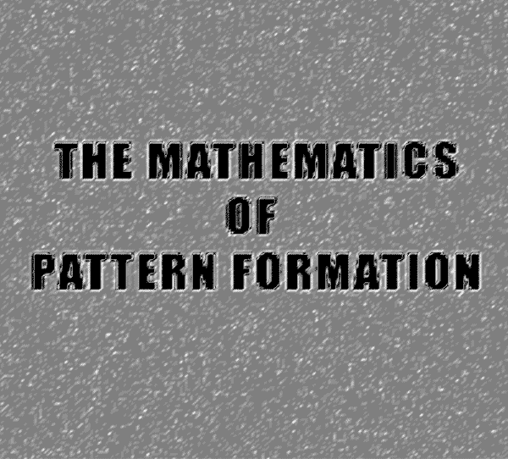

Slide 4
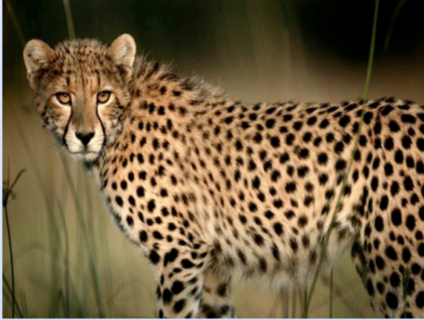
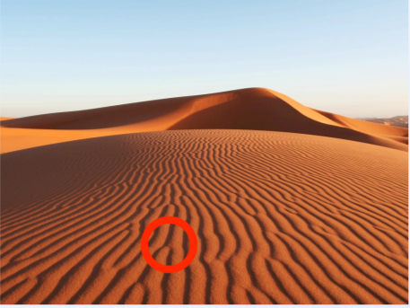
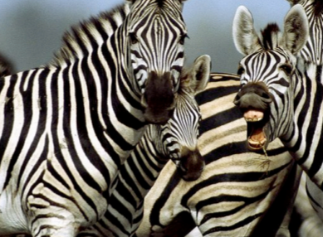
How cells organize themselves into particular patterns?
How do amazing patterns occur in nature, starting from relatively simple, regular, and symmetric conditions?

Slide 5
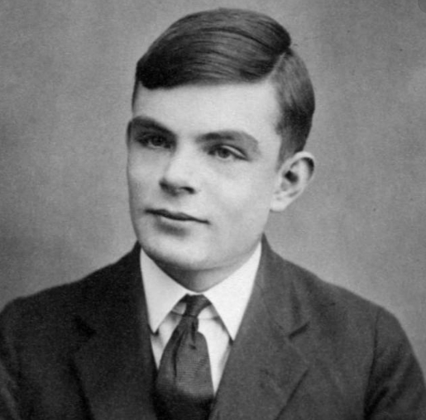

Slide 6
Outline
How Reaction-Diffusion forms pattern?
Examples
History of Pattern formation study using Reaction-Diffusion models.

Slide 7
Reaction Diffusion (RD)
A chemical mechanism for pattern formation
Two chemicals diffusing across a surface and reacting with one another can form stable patterns of chemical concentration

Slide 8
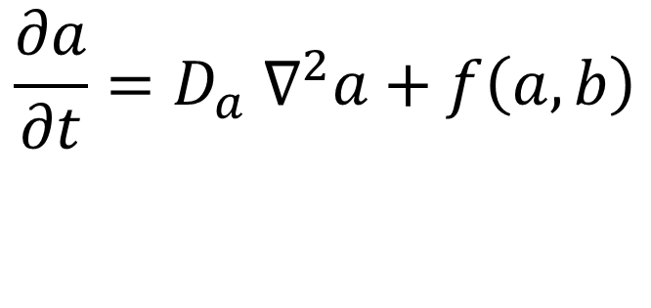
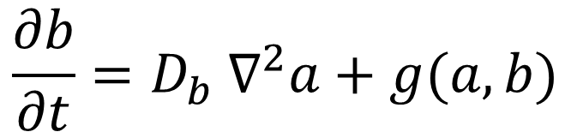
Mathematical Model
$$\frac{∂a}{∂t}=D_{a} ∇^{2}a+f\left(a,b\right)$$
$$\frac{∂b}{∂t}=D_{b} ∇^{2}a+g(a,b)$$

Slide 9
Analytical Solution?
Closed-form solution: difficult/impossible (except when F,G very simple)
Therefore:
Discretize
Solve numerically

Slide 10
Turing Instability
A diffusion driven instability ( Turing Instability), occurs when a steady state, stable in the absence of diffusion, becomes unstable when diffusion is present.

Slide 11
Conditions for Turing Instabilities
Stability in the zero-diffusion case so that if the chemicals are not diffusing, or they diffuse at the same rate, they will tend to go to an equilibrium state.
Instability when diffusion is added such that a small perturbation away from equilibrium will lead to a (drastic) change in the spatial structure and patterns will form.

Slide 12
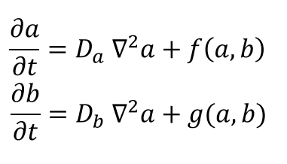
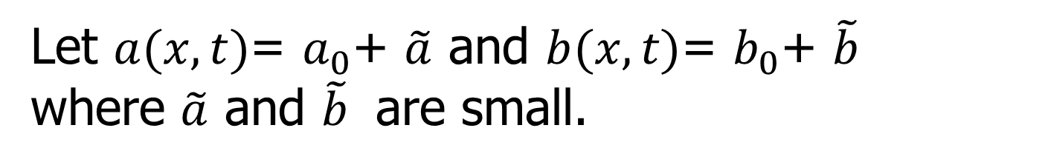
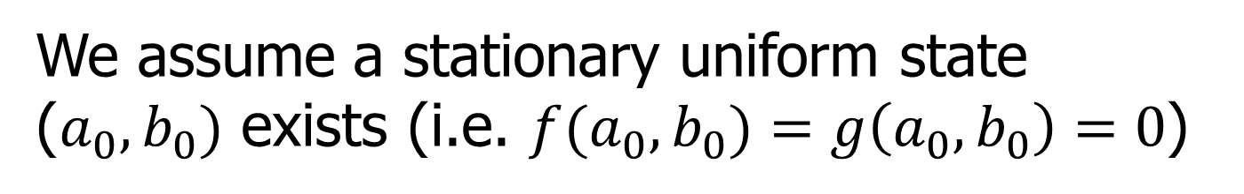
We assume a stationary uniform state ($a_{0},b_{0})$ exists (i.e. ${f(a}_{0},b_{0})=g\left(a_{0},b_{0}\right)=0$)
Let $a(x,t)$= $a_{0}$+ $\tilde{a}$ and $b(x,t)$= $b_{0}$+ $\tilde{b}$
where $\tilde{a}$ and $\tilde{b}$ are small.

Slide 13
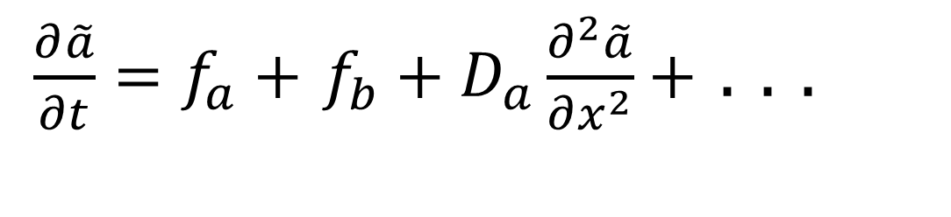
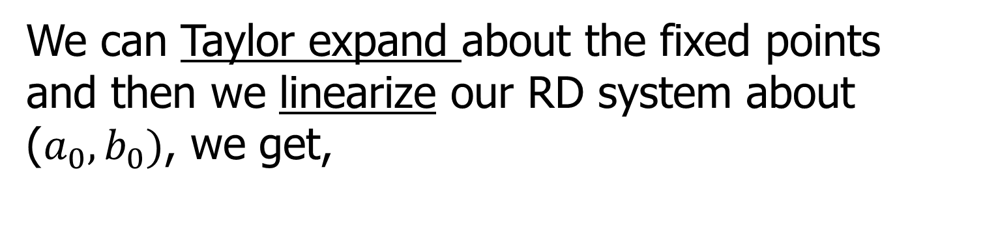
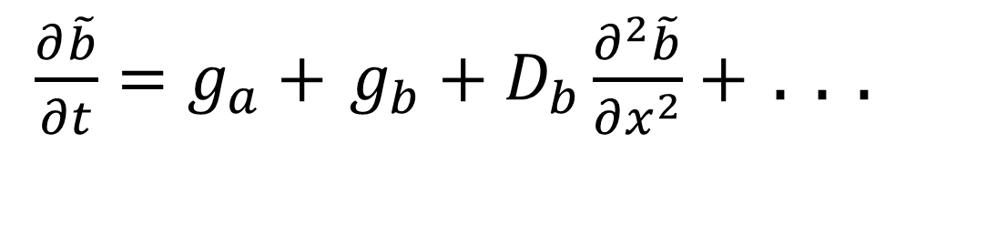
We can Taylor expand about the fixed points
and then we linearize our RD system about ($a_{0},b_{0})$, we get,
$\frac{∂\tilde{a}}{∂t}=f_{a}+$ $f_{b}+D_{a}\frac{∂^{2}\tilde{a}}{∂x^{2}}+$ . . .
$\frac{∂\tilde{b}}{∂t}=g_{a}+$ $g_{b}+D_{b}\frac{∂^{2}\tilde{b}}{∂x^{2}}+$ . . .

Slide 14
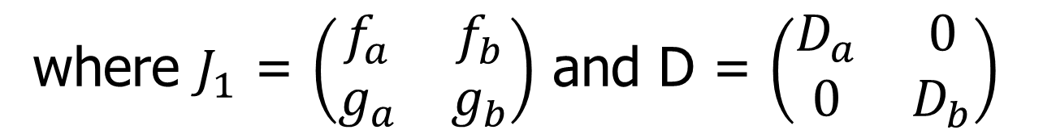
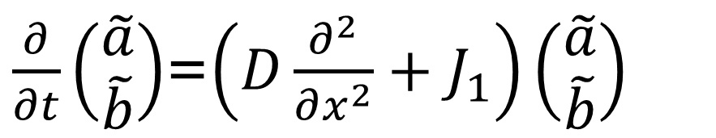
In matrix notation
$\frac{∂}{∂t}\left(\begin{matrix}\tilde{a} \\ \tilde{b}\end{matrix}\right)$=$\left(D\frac{∂^{2}}{∂x^{2}}+J_{1}\right)\left(\begin{matrix}\tilde{a} \\ \tilde{b}\end{matrix}\right)$
where $J_{1}$ = $\left(\begin{matrix}f_{a} & f_{b} \\ g_{a} & g_{b}\end{matrix}\right)$ and D = $\left(\begin{matrix}D_{a} & 0 \\ 0 & D_{b}\end{matrix}\right)$

Slide 15
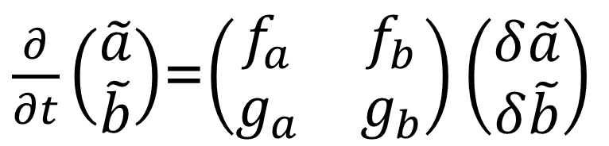
The diffusion-less linearized system has the following form:
$\frac{∂}{∂t}\left(\begin{matrix}\tilde{a} \\ \tilde{b}\end{matrix}\right)$=$\left(\begin{matrix}f_{a} & f_{b} \\ g_{a} & g_{b}\end{matrix}\right)\left(\begin{matrix}δ\tilde{a} \\ δ\tilde{b}\end{matrix}\right)$

Slide 16
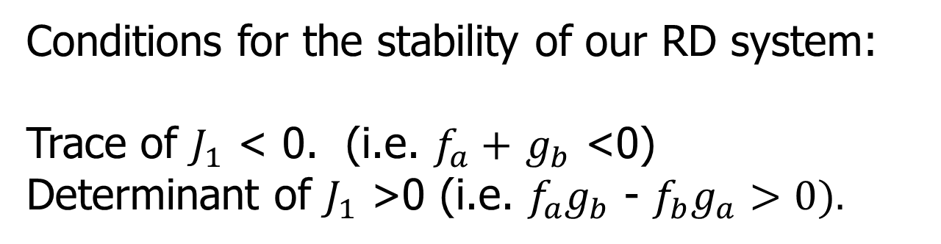
Conditions for the stability of our RD system:
Trace of $J_{1}$ < 0. (i.e. $f_{a}+$ $g_{b}$ <0)
Determinant of $J_{1}$ >0 (i.e. $f_{a}g_{b}$ - $f_{b}g_{a}>0).$

Slide 17
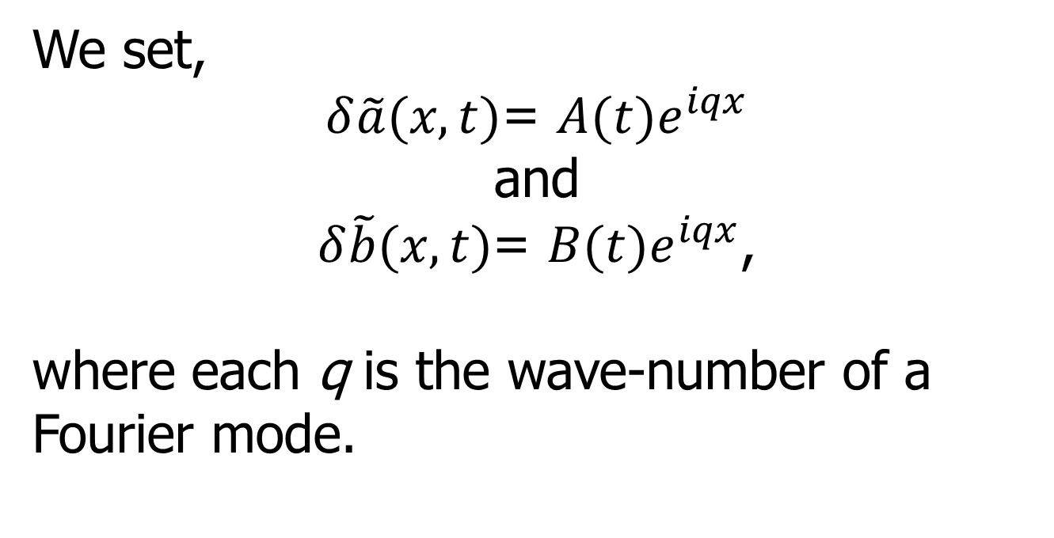
We set,
$δ\tilde{a}(x,t)$= ${A(t)e}^{iqx}$
and
$δ\tilde{b}(x,t)$= ${B(t)e}^{iqx}$,
where each q is the wave-number of a Fourier mode.

Slide 18
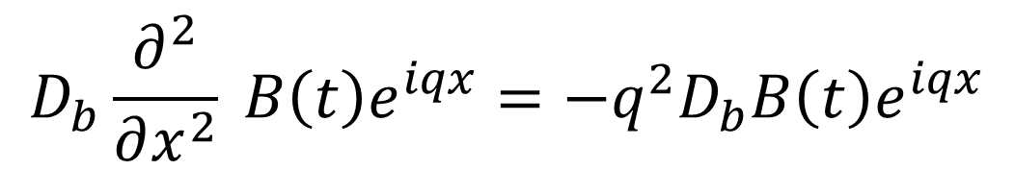
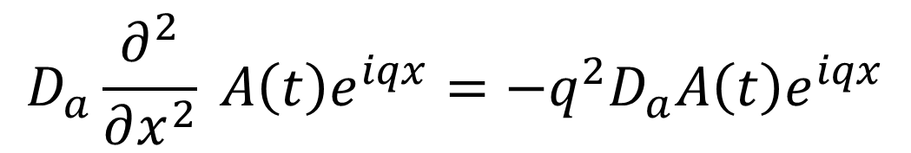
$$D_{a}\frac{∂^{2}}{∂x^{2}} A\left(t\right)e^{iqx}=−q^{2}D_{a}A\left(t\right)e^{iqx}$$
$$D_{b}\frac{∂^{2}}{∂x^{2}} B\left(t\right)e^{iqx}=−q^{2}D_{b}B\left(t\right)e^{iqx}$$

Slide 19
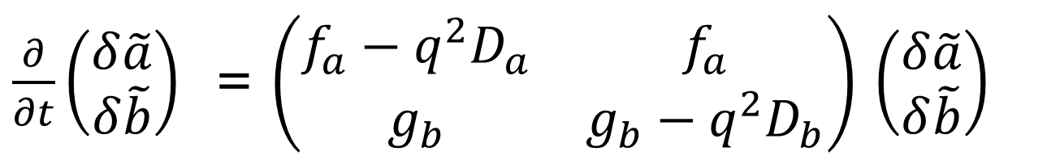
After we perturb the system by find that the Jacobian for this system is:
$\frac{∂}{∂t}\left(\begin{matrix}δ\tilde{a} \\ δ\tilde{b}\end{matrix}\right)$ = $\left(\begin{matrix}{f_{a}−q^{2}D}_{a} & f_{a} \\ g_{b} & {g_{b}−q^{2}D}_{b}\end{matrix}\right)$ $\left(\begin{matrix}δ\tilde{a} \\ δ\tilde{b}\end{matrix}\right)$

Slide 20
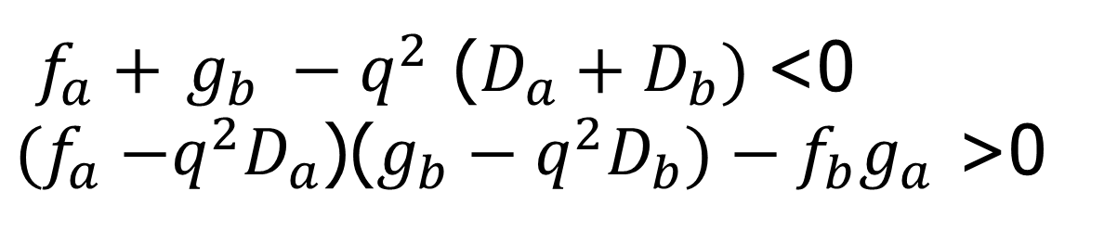
$f_{a}+$ $g_{b} −q^{2}$ ($D_{a}+D_{b})$<0
${(f}_{a} −q^{2}D_{a}$)($g_{b}−q^{2}D_{b})−f_{b}g_{a}$ >0

Slide 21
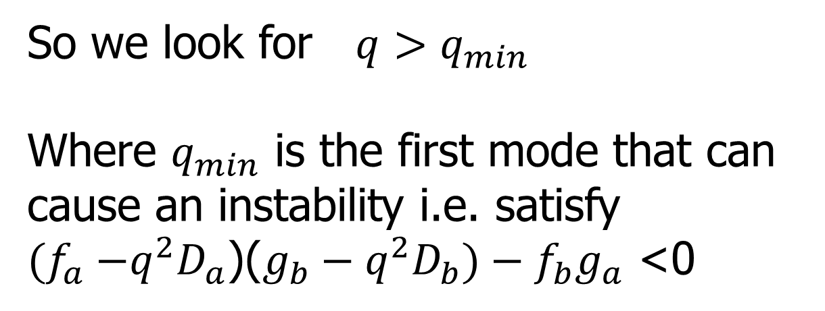
So we look for $q>q_{min}$
Where $q_{min}$ is the first mode that can cause an instability i.e. satisfy
${(f}_{a} −q^{2}D_{a}$)($g_{b}−q^{2}D_{b})−f_{b}g_{a}$ <0

Slide 22
The Gierer-Meinhardt model
a reaction diffusion system that describes an activator-inhibitor interaction

Slide 23
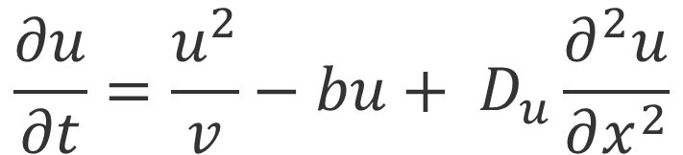
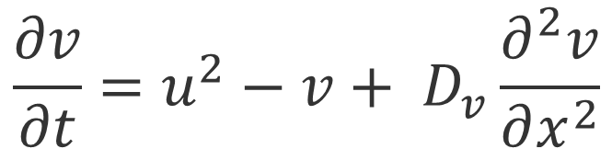
$$\frac{∂u}{∂t}=\frac{u^{2}}{v}−bu+ D_{u}\frac{∂^{2}u}{∂x^{2}}$$
$$\frac{∂v}{∂t}=u^{2}−v+ D_{v}\frac{∂^{2}v}{∂x^{2}}$$

Slide 24
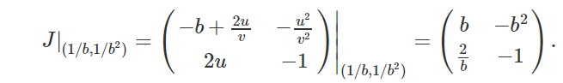
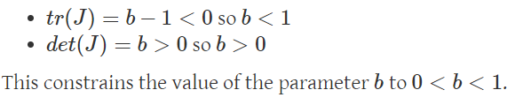

Slide 25
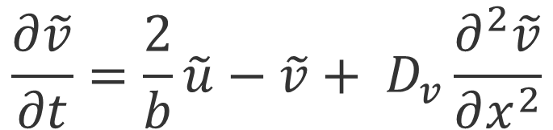
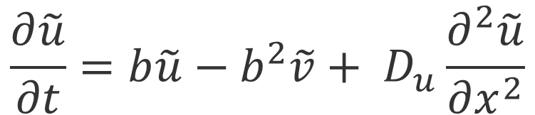


$$\frac{∂\tilde{u}}{∂t}=b\tilde{u}−b^{2}\tilde{v}+ D_{u}\frac{∂^{2}\tilde{u}}{∂x^{2}}$$
$$\frac{∂\tilde{v}}{∂t}=\frac{2}{b}\tilde{u}−\tilde{v}+ D_{v}\frac{∂^{2}\tilde{v}}{∂x^{2}}$$
where $u\left(x,t\right)= u_{0}+$ $\tilde{u}$
and $v\left(x,t\right)= v_{0}+$ $\tilde{v}$

Slide 26
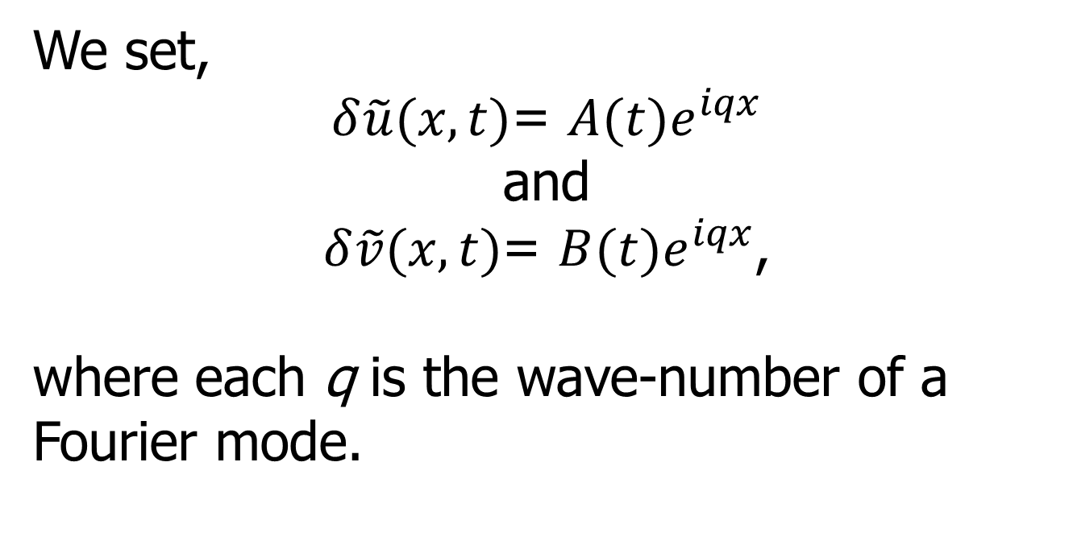
We set,
$δ\tilde{u}(x,t)$= ${A(t)e}^{iqx}$
and
$δ\tilde{v}(x,t)$= ${B(t)e}^{iqx}$,
where each q is the wave-number of a Fourier mode.

Slide 27
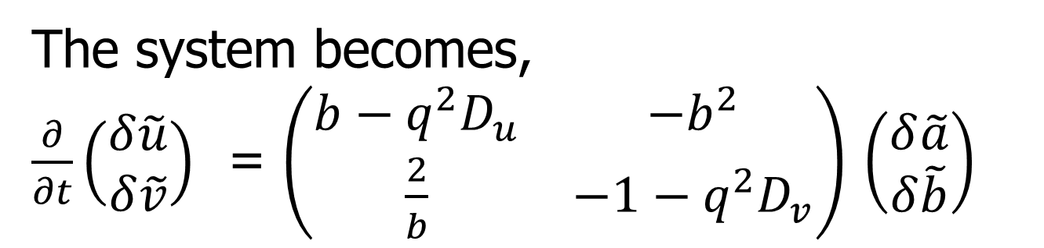
The system becomes,
$\frac{∂}{∂t}\left(\begin{matrix}δ\tilde{u} \\ δ\tilde{v}\end{matrix}\right)$ = $\left(\begin{matrix}{b−q^{2}D}_{u} & −b^{2} \\ \frac{2}{b} & {−1−q^{2}D}_{v}\end{matrix}\right)$ $\left(\begin{matrix}δ\tilde{a} \\ δ\tilde{b}\end{matrix}\right)$

Slide 28
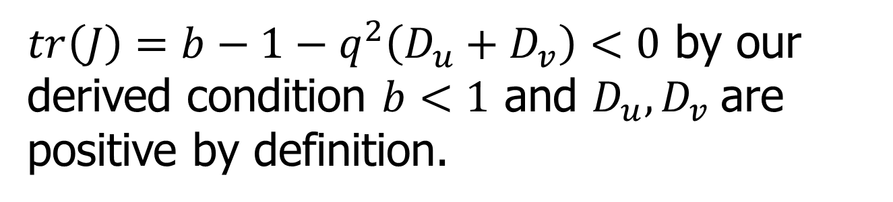
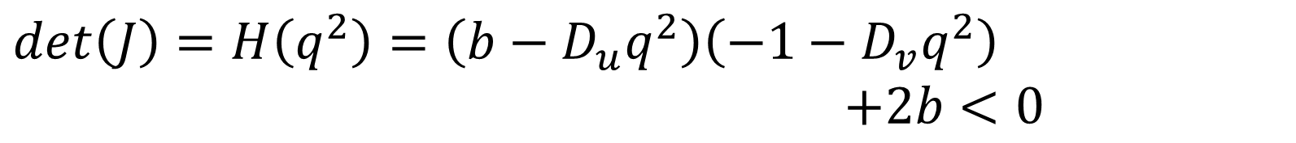
Notice that the determinant is a quadratic function with respect to
$tr\left(J\right)=b−1−q^{2}\left(D_{u}+D_{v}\right)<0$ by our derived condition $b<1$ and $D_{u},D_{v}$are positive by definition.
In order for the system become unstable,
we need,
$\det\left(J\right)=H\left(q^{2}\right)=\left(b−D_{u}q^{2}\right)\left(−1−D_{v}q^{2}\right)$ $+2b<0$

Slide 29
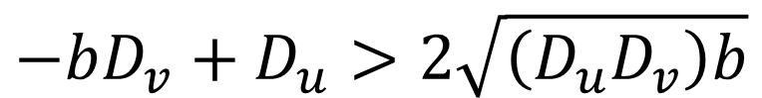
We will get two real roots for the quadratic when,
$$−bD_{v}+D_{u}>2\sqrt{\left(D_{u}D_{v}\right)b}$$

Slide 30
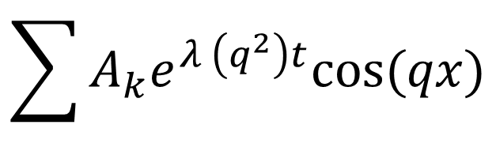

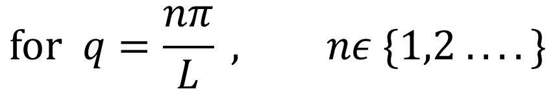
Spatial Domain
If we apply periodic boundary conditions over a domain $x∈\left[0,L\right],$ the separable solution will then of the form
$$\sum{A_{k}e^{λ \left(q^{2}\right)t}cos⁡(qx)}$$
$$for q=\frac{nπ}{L} , nε \{1,2 . . . .\}$$

Slide 31
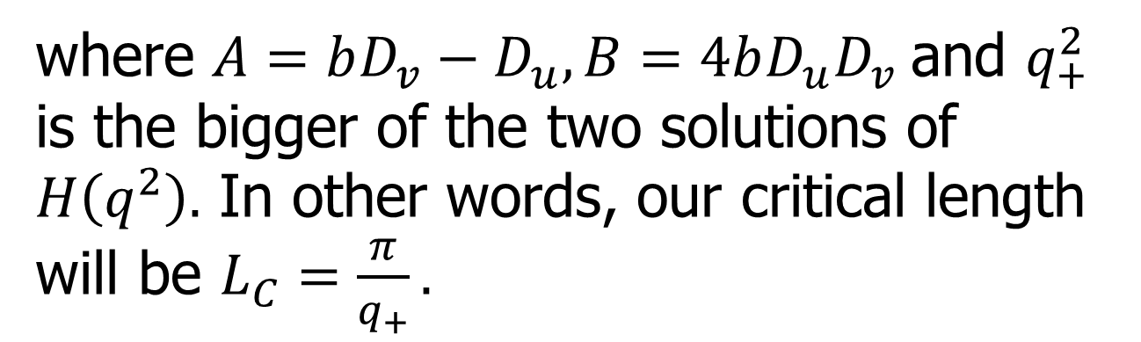
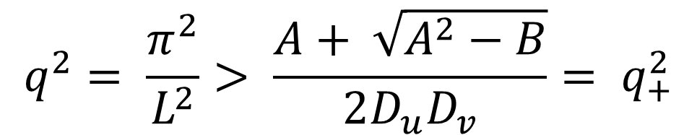
Since we want patterns to form, then the smallest allowed L has to be such that,
$$q^{2}= \frac{π^{2}}{L^{2}}> \frac{A+ \sqrt{A^{2}−B}}{2D_{u}D_{v}}= q_{+}^{2}$$
where $A=bD_{v}−D_{u}, B=4bD_{u}D_{v}$and $q_{+}^{2}$ is the bigger of the two solutions of $H\left(q^{2}\right).$ In other words, our critical length will be $L_{C}=\frac{π}{q_{+}}.$

Slide 32
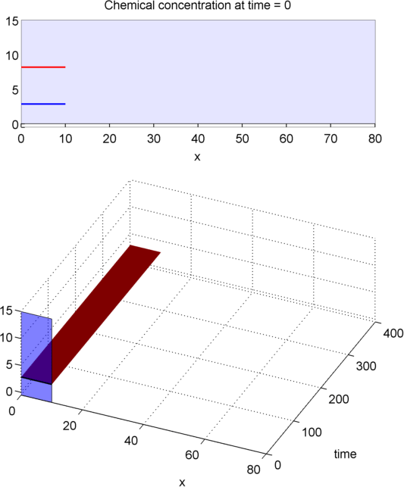
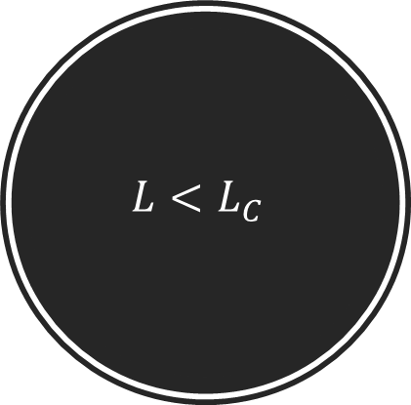
$$L<L_{C}$$

Slide 33
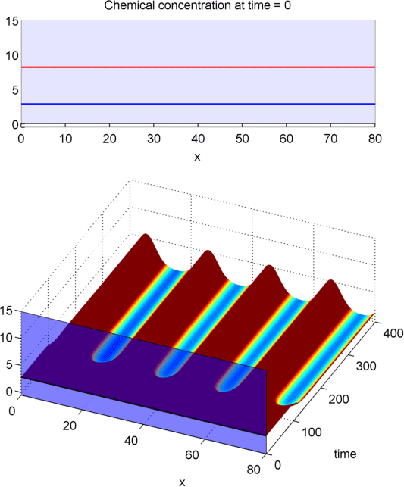

$$L>L_{C}$$

Slide 34
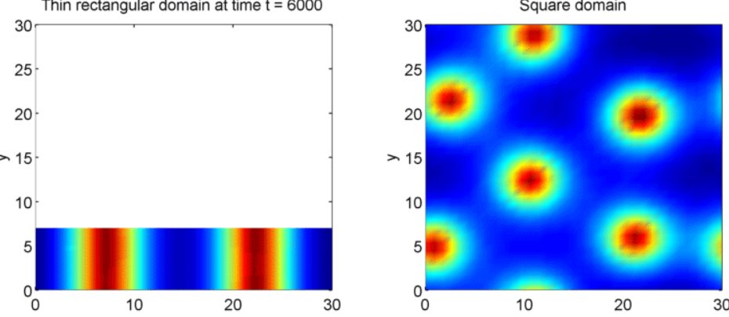
2D Gierer Meinhardt

Slide 35
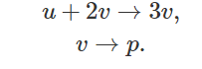
Gray-Scott model

Slide 36
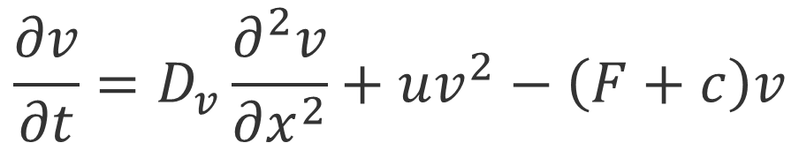
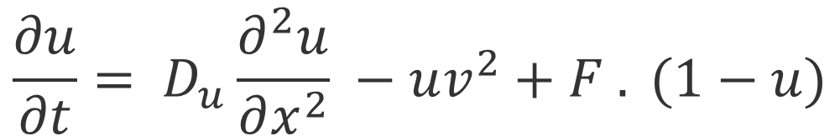
The evolution of the concentration of u and v are described by,
$$\frac{∂u}{∂t}= D_{u}\frac{∂^{2}u}{∂x^{2}} −uv^{2}+F . (1−u)$$
$$\frac{∂v}{∂t}=D_{v}\frac{∂^{2}v}{∂x^{2}}+uv^{2}−\left(F+c\right)v$$

Slide 37
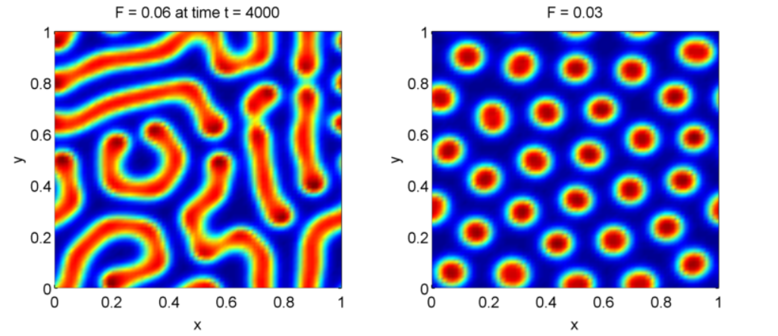

Slide 38
History of RD
Turing (1952)
RD system on a sphere may be responsible for triggering gastrulation in the embryo.
Bard and Lauder (1974)
Computer simulations → Patterns generated by RD not regular enough to explain patterns in development.
Can explain less regular patterns: leaf organization, distribution of hair follicles.

Slide 39
Bard (1981), Murray (1981) independently
RD can explain the patterns on coats of animals.
Bard (1981)
Spot and stripe patterns.
Small, white spots on a deer.
Large, dark spots on a giraffe.
Murray (1981)
Spot-size dependent on size of animal.
Patterns found on butterfly wings.

Slide 40
Meinhardt (1982)
Stripe patterns (by 5-morphogen RD)
Veins on a leaf.
Swindale (1980)
Simulation by activation/inhibition between synapses.
Young (1984)
Irregular striped patterns
Ocular dominance columns in mammalian visual system.
Meinhardt and Klinger (1987)
Patterns of pigment found on mollusc shells

Slide 41
Web Resources
http://mrob.com/pub/comp/xmorphia/
http://groups.csail.mit.edu/mac/projects/amorphous/GrayScott/

Slide 42
References
A. Turing. “The Chemical Basis of Morphogenesis,” Philosophical Transactions of the Royal Society B, vol. 237, pp 37-72 (August 14, 1952).
Kharab, A. and Guenther, R. B. (2006). An introduction to numerical methods: a MATLAB approach. Boca Raton: Chapman & Hall, 2 edition.
Murray, J. and Sperb, R. (1983). Minimum domains for spatial patterns in a class of reaction diffusion equations. Journal of mathematical biology, 18(2):169–184.

